Slide 1
YOurknow

Slide 2
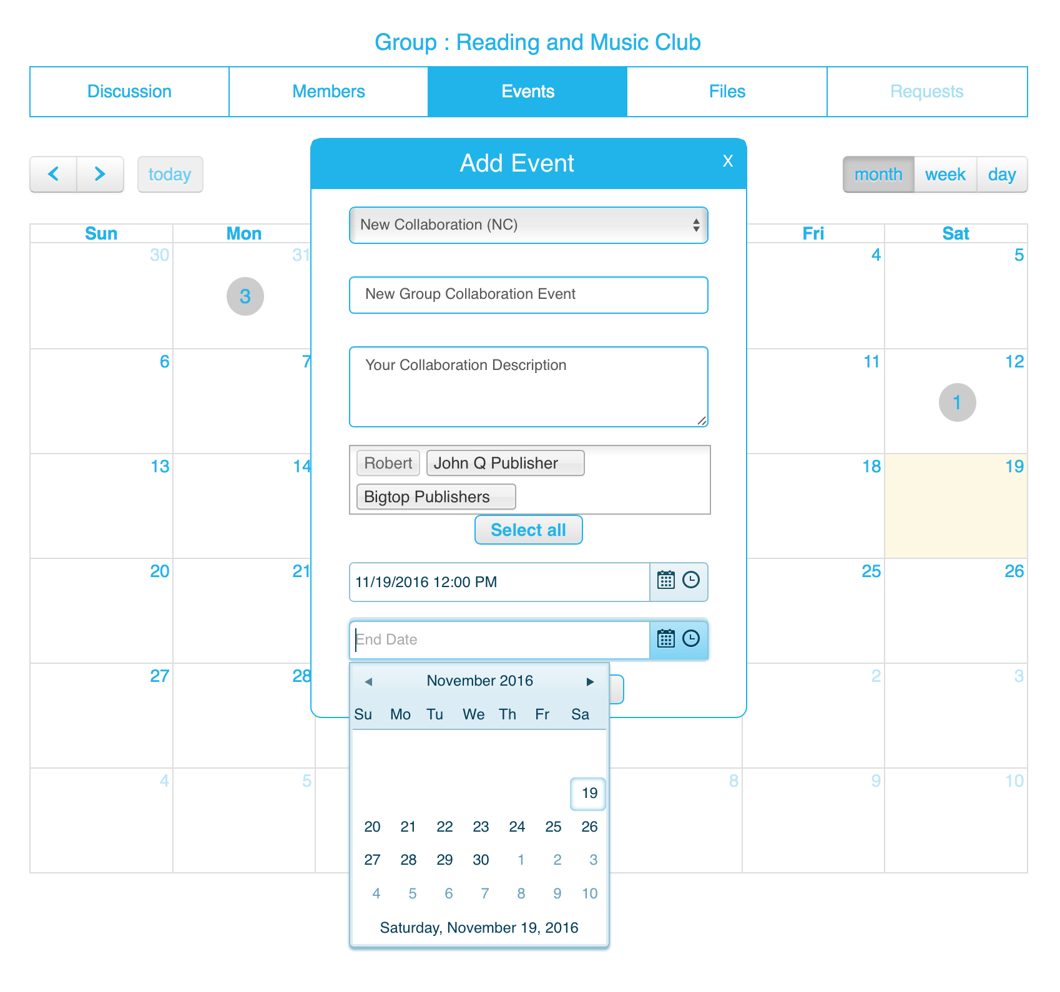
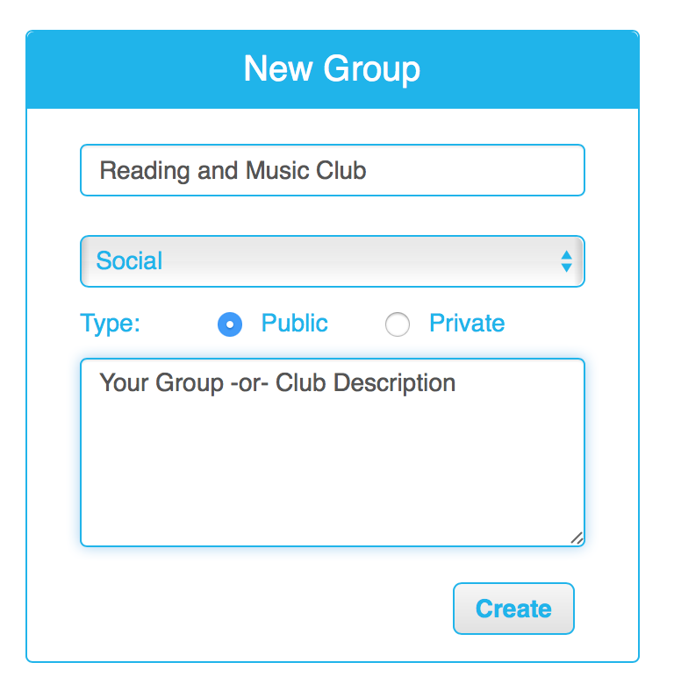
How It Works:
Members - can create groups, collaboration events, and invite others to participate from anywhere

